Slide 1
Data Science and AI Lab Project
GROUP I
RAG-BASED LLM CODE REVIEW AGENT
MILESTONE 3

Slide 2

Objectives
Design architecture for Code Review Assistant
Process PR diffs → structured outputs
Use the Retrieval-Augmented (RAG) approach
Combine retrieval + lightweight generation
Ensure an explainable & modular system
Build and validate working prototype

Slide 3
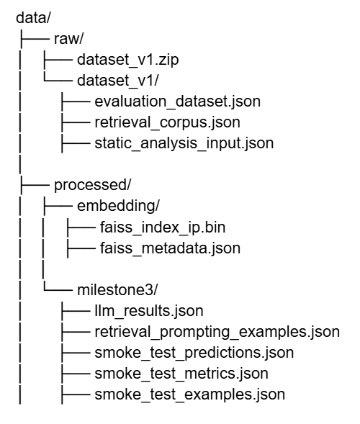

Dataset Organization
&
Components
01
Data Structure
Two layers: Raw Data & Processed Data
Ensures clear separation & modular design
02
Directory Overview
raw/ → original datasets
Evaluation dataset
Retrieval corpus
Static analysis input
processed/ → embeddings & outputs
FAISS index
Milestone 3 results
03
Core Datasets
Evaluation Dataset
PR diffs + labeled review comments
Evaluation Dataset
Coding guidelines (PEP8, linters, reviews)
Evaluation Dataset
Rule-based baseline comparison

Slide 4



Data Flow & Design Principles
Pipeline Flow
PR Diff → Preprocessing
→ Embedding Generation
→ FAISS Retrieval (Top-K)
→ Context + Prompt Creation
→ LLM Inference
→ Output: Violations + Review Comments
Generated Outputs
Predictions & evaluation metrics
Retrieved context + prompts
LLM-generated results
Design Principles
Separation of raw & processed data
Scalable & reproducible pipeline
Optimized for RAG architecture
Fast semantic search using FAISS

Slide 5

Data Preprocessing Pipeline
01
Purpose
Convert raw PR diffs → structured inputs
Enable semantic retrieval + LLM inference
02
Evaluation Dataset Processing
Extract relevant diff chunks
Clean & normalize code (remove symbols)
Build context: file path + diff + metadata
Optional tokenization for hints
03
Retrieval Corpus Processing
Clean & normalize documents
Split into 200–400 token chunks
Add metadata: category, source, chunk ID
04
Embedding Generation
Model: BGE-large (SentenceTransformers)
Convert queries & corpus → vectors
Normalize embeddings for similarity search

Slide 6
Retrieval, Prompting & Output
FAISS Indexing
Store embeddings for fast retrieval
Top-K similarity search (K=5)
Returns relevant guideline chunks
Retrieval & Context Formation
Query → embedding → FAISS search
Retrieve top relevant rules
Build structured context (text + metadata)
Prompt Construction
Combine:
PR diff
Retrieved guidelines
Instructions
Enforces structured JSON output
Final Output:
Generates violation category and context-aware review comment based on retrieved guidelines.

Slide 7
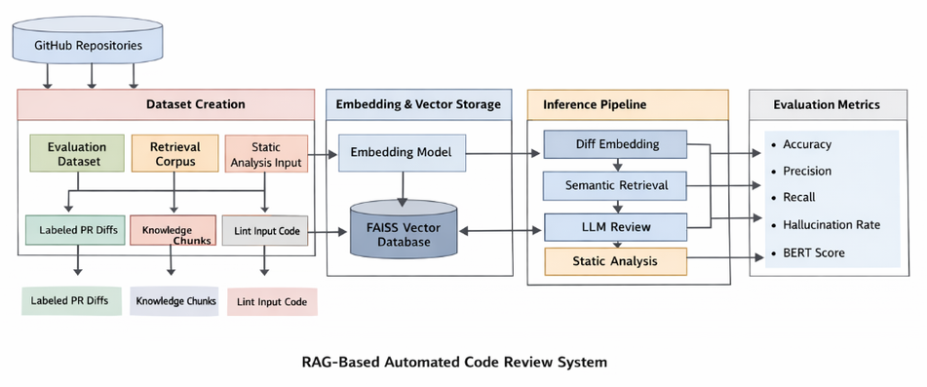
Model Architecture Overview
Approach
Retrieval-Augmented Generation (RAG-based system)
Combines semantic retrieval + LLM reasoning
Input Unit
Single violation instance
Includes: diff chunk, file path, line number, PR metadata
Pipeline Stages
Preprocessing & query construction
Embedding generation
FAISS-based retrieval
Prompting + LLM generation
Grounding & validation
Key Goal :
Generate accurate, explainable review comments

Slide 8
Core Components
01
Diff Processing
Extract diff chunks based on line numbers
Clean diff (remove symbols, preserve structure)
Segment into 20–50 line chunks
02
Embedding & Retrieval
Model: BAAI/bge-large-en-v1.5
SentenceTransformers
Dense vector embeddings (normalized)
03
Prompt Construction
Combines:
PR diff
Retrieved guidelines
Metadata + instructions
Ensures structured JSON output
04
LLM Generation
Outputs:
Violation category
Grounded review comment

Slide 9
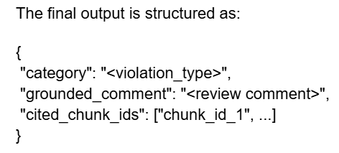
Validation, Output & Design
Grounding & Validation
Check alignment with retrieved evidence
Detect hallucinations
Measure grounding quality
Static Analysis (Baseline)
Tools: Flake8, Pylint
Compare:
Rule-based vs LLM vs RAG
Final Output Format
Category + review comment
Includes referenced guideline chunks
Limitations
Limited evaluation dataset size
Limited retrieval corpus coverage
Imbalance across violation categories
Depends on prompt design and LLM behavior

Slide 10
Input & Embedding Representation
Input
Diff chunk
File path
Repo metadata (repo, PR ID, line no.)
{
"chunk_id": "...",
"text": "...",
"category": "...",
"source_type": "..."
}
Retrieval Corpus Representation
Embedding Representation
Model: BAAI/bge-large-en-v1.5
Vector: 1024-dim, L2-normalized

Slide 11
Retrieval & Prompt Construction
FAISS Retrieval
Prompt Structure (LLM Input)
[Instruction]
Context:
- repo
- file_path
- line_number
- category_hint (optional)
Diff:
<diff_chunk>
Retrieved Evidence:
- chunk_id, category, source, score, text
Output Format:
JSON with fields:
- category
- grounded_comment
- cited_chunk_ids
Stores corpus embeddings
Input: query vector (1×1024)
Output:
Top-K results (k=5)
Similarity scores

Slide 12
END-END PIpeline
Input Processing
01
Generate structured query from PR diff (file path + diff chunk)
02
Embedding (BGE-large)
Convert query into 1024-dimensional L2-normalized vector
03
FAISS Retrieval (Top-K)
Retrieve Top-K = 5 most similar guideline chunks
04
Prompt Construction
Combine instruction, metadata, diff, and retrieved evidence
05
LLM Inference
Generate code review using structured prompt
06
Structured Output (JSON) and Evaluation
Produce category, grounded_comment, and cited_chunk_ids and Evaluate.

Slide 13
OUTput representation
Stored Files
Sample Output
smoke_test_predictions.json
-full predictions
smoke_test_metrics.json
-Evaluation metrics
smoke_test_examples.json
- Sample outputs
{
"pr_id": "PR_4682",
"repo": "pallets/flask",
"file_path": "src/flask/globals.py",
"line_number": 73,
"gold_category": "naming_convention",
"groq_predicted_category": "unused_import",
"groq_grounded_comment": "Remove the unused imports of `functools.partial` and `werkzeug.local.LocalStack` to keep the module clean.",
"groq_cited_chunks": ["chunk_0600", "chunk_0571"]
}

Slide 14
Evaluation setup
One-vs-rest classification per violation category
Prediction is correct if:
Line number matches (± tolerance)
Category matches ground truth
Outputs compared against ground truth:
True Positive (TP): Correct prediction of a violation category
False Positive (FP): Incorrect prediction of a category
False Negative (FN): Missed violation
True Negative (TN): Correct rejection of non-category
Grounding Evaluation
Latency Setup
Based on retrieved knowledge
Grounded if:
References guideline
Cites standard
Aligns with retrieved docs
Measured per instance
Same hardware for all systems
RAG:
Retrieval + Generation
LLM:
Generation only
Static tools:
Analysis runtime

Slide 15
Evaluation METRIcs
Classification Metrics
Precision = TP / (TP + FP)
Recall = TP / (TP + FN)
F1 Score = balance of precision & recall
Macro F1 → average across categories
Grounding Rate
Grounding Rate = grounded / total
Semantic Alignment
Compared with human reviews
Metric: BERTScore (F1)
Threshold: > 0.85
Hallucination Rate
Incorrect or unsupported outputs
Hallucination Rate = hallucinated / total
Latency Metrics
Mean latency → average performance
P95 latency → worst-case performance

